Slide 1
ICDS Final Project
Shuochen Zhou (sz4544)
Ziqi Gu (zg2598)
Wentao He (wh2538)
Notes:
Source Genres

Slide 2
In this project…
Graphic User Interface (GUI)
Secure Messaging (RSA)
Online Gaming (Tic-Tac-Toe)
GPT Integration (gpt-3.5-turbo)
Notes:
This video will introduce some common types of sources and give an overview of how you might use them in your research. We'll talk about encyclopedias and dictionaries, books, journal articles, newspaper and magazine articles and websites. There'll be a summary at the end.

Slide 3
Introduction

Slide 4
Graphic User Interface (GUI)
Notes:
Encyclopedias and Dictionaries

Slide 5
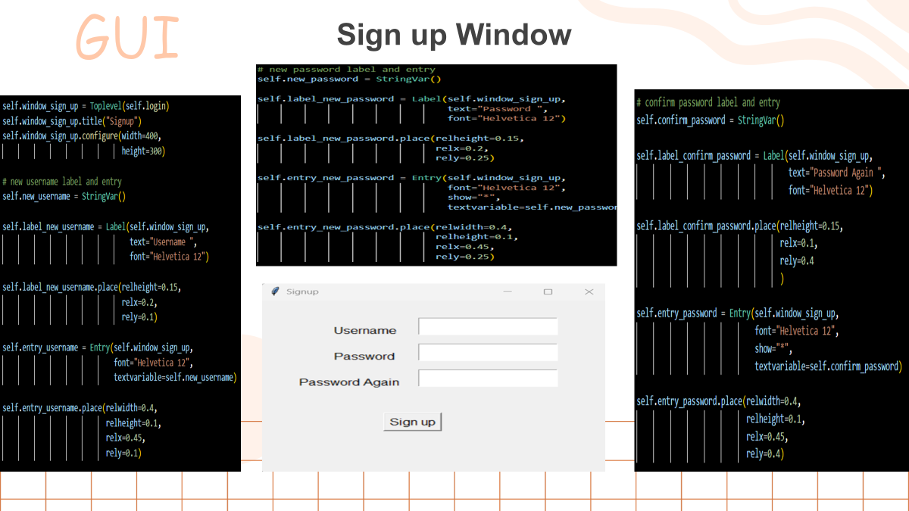
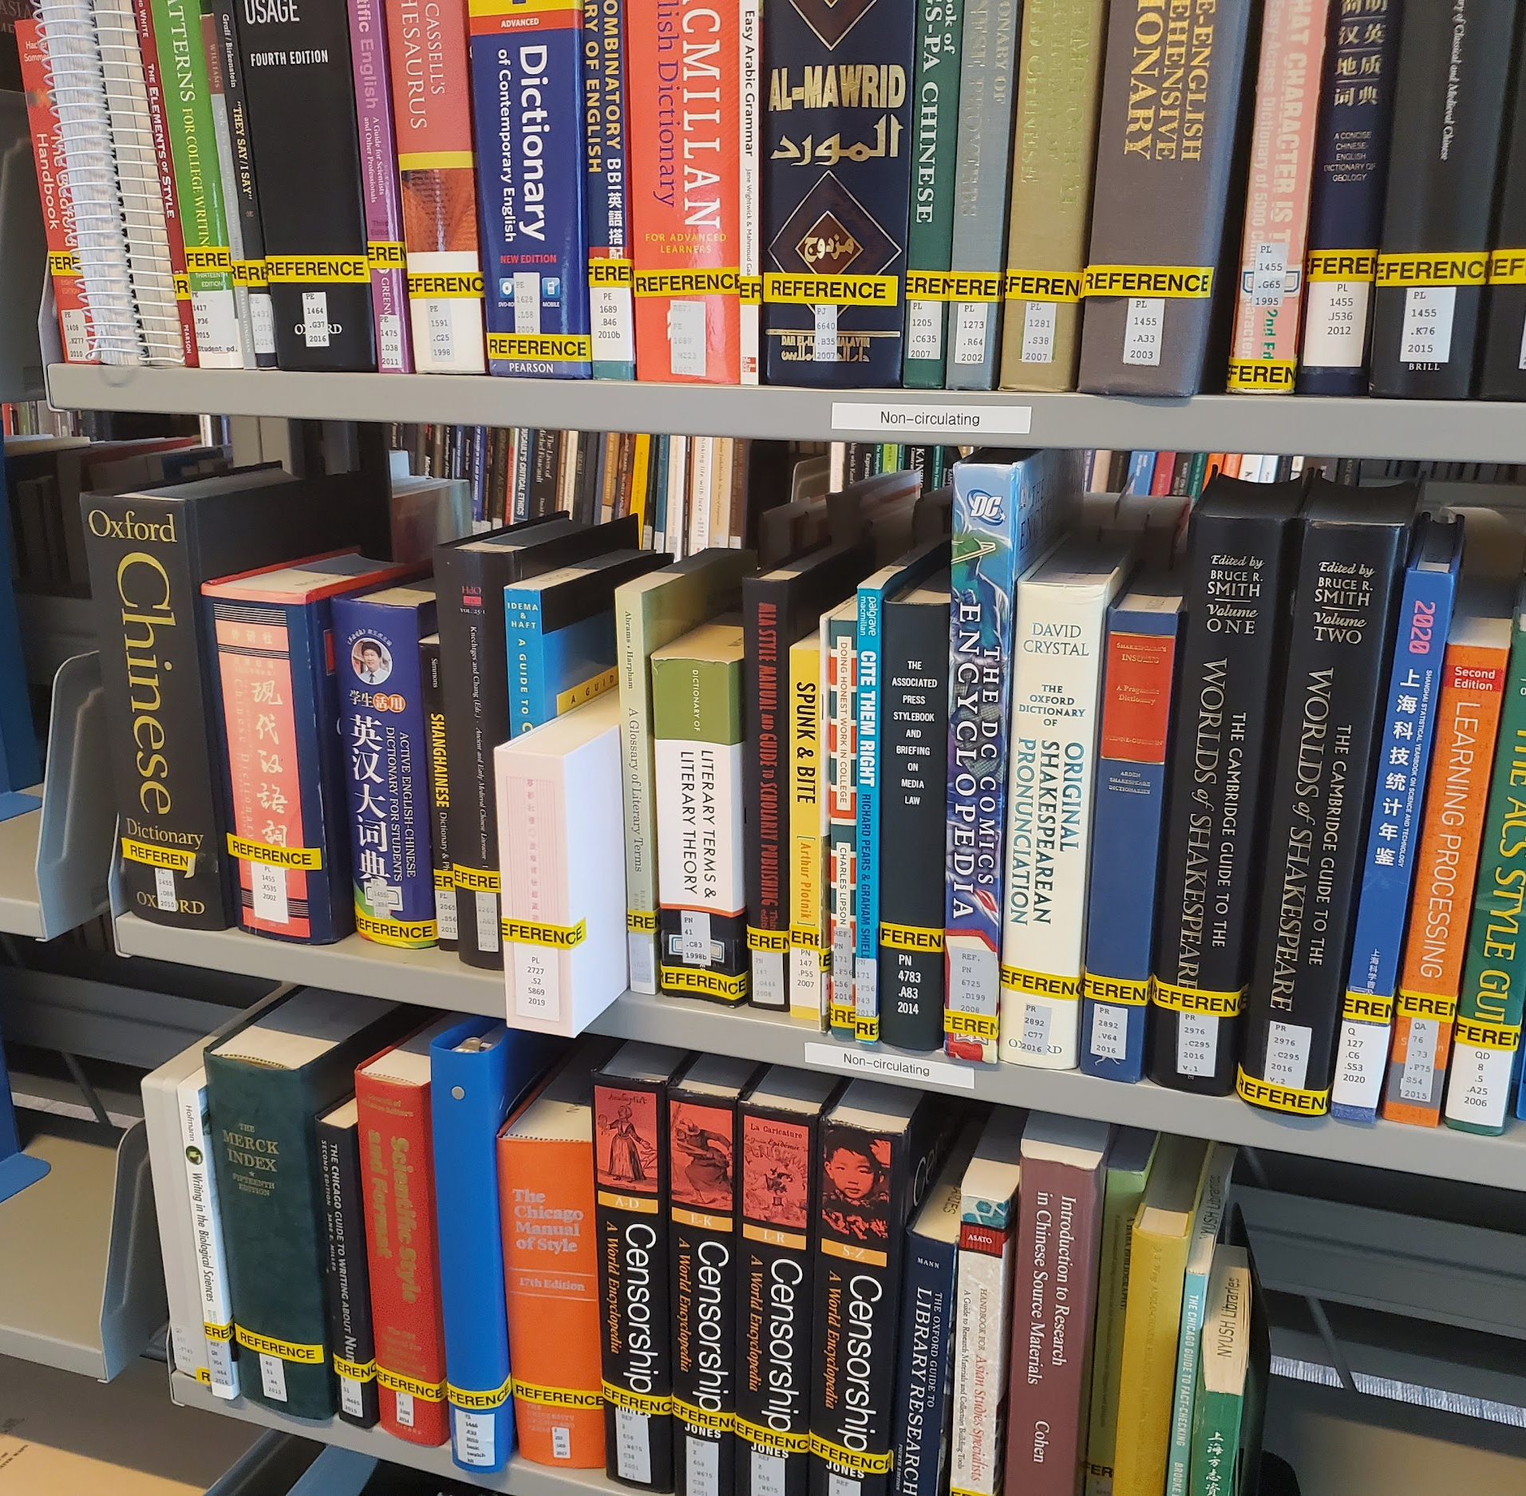
Encyclopedias and Dictionaries
Reference sources
Background info and facts
Academic or “popular”
Notes:
Encyclopedias and dictionaries are also called reference sources and contain background information or facts that are well accepted. They can be academic or popular sources.

Slide 6
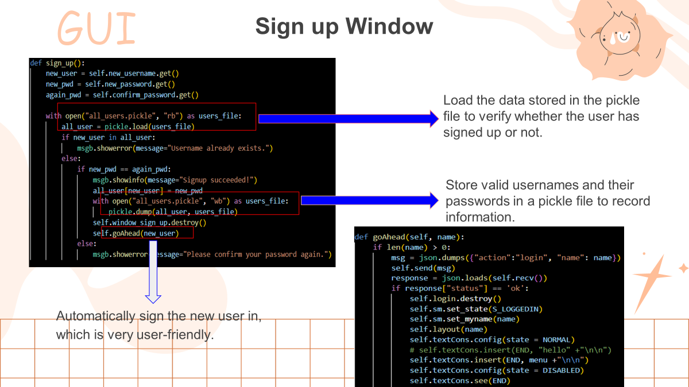
Academic
Popular
Also called “scholarly” sources
Created for researchers and students
Share and support research
Include citations
Created for a general audience
Usually don’t require prior knowledge
Usually no formal citations
Notes:
cademic sources, also called scholarly sources, are designed for researchers and sometimes students to read. These sources are created to share and support research on a subject. Academic sources usually assume the person reading knows something about the subject. They should include citations and references to show that the information in the text comes from academic research. The term popular sources refers to non-academic sources aimed at a general audience. Usually these sources are easy to understand if you haven't studied the topic, and they don't usually have citations or references.

Slide 7
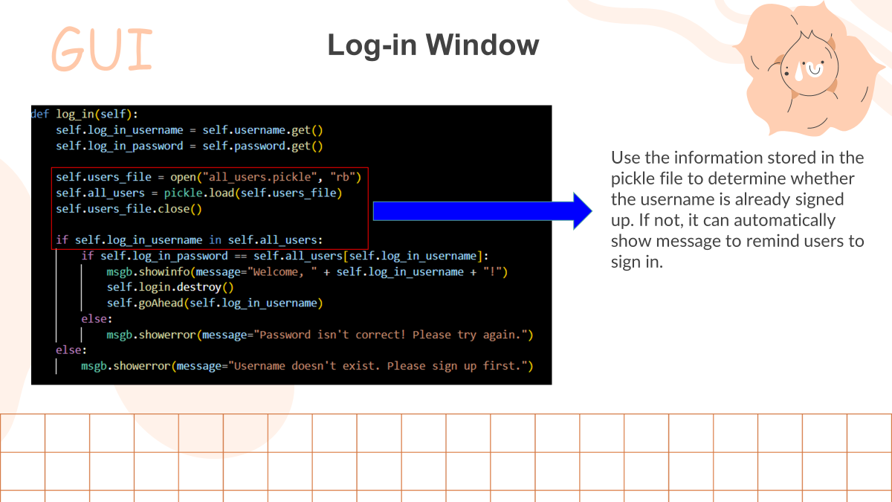
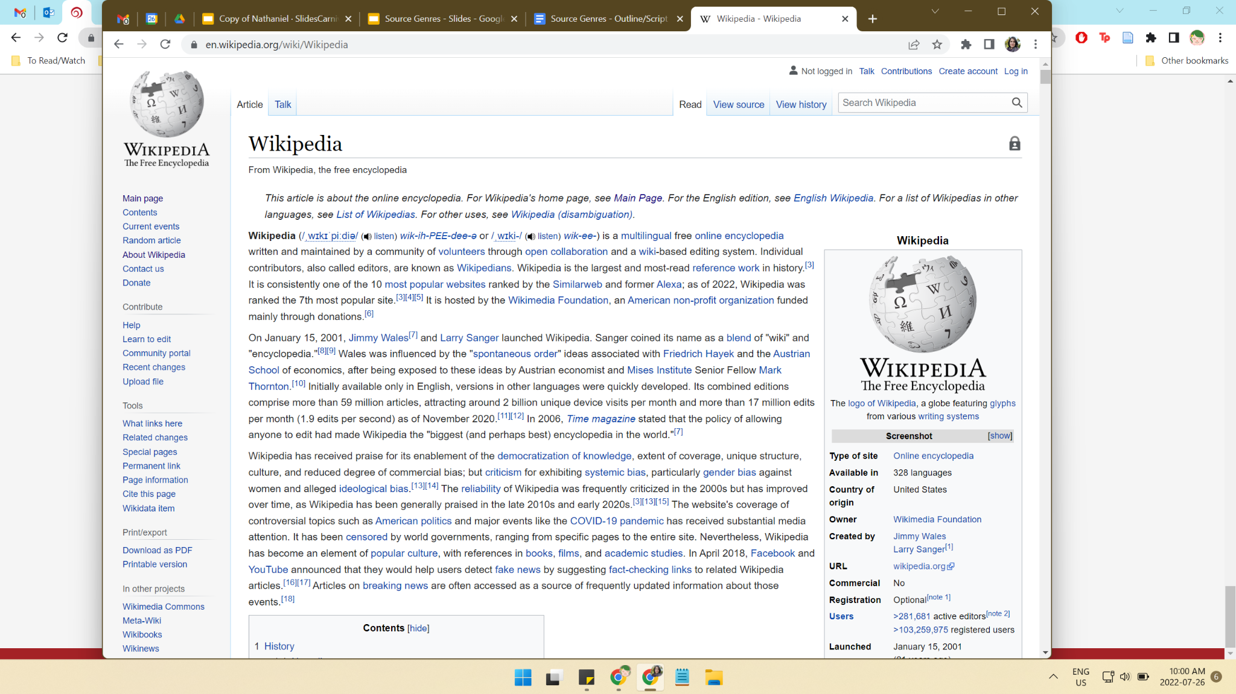
Wikipedia is an encyclopedia for “popular” audiences
Notes:
You might be familiar with Wikipedia, which is an encyclopedia aimed at a popular audience. Wikipedia includes citations and has more in-depth information than most popular sources, so it can be useful for a quick introduction to a topic. But if you need information for research and plan to cite it, the academic reference sources in the library are usually a better choice.

Slide 8
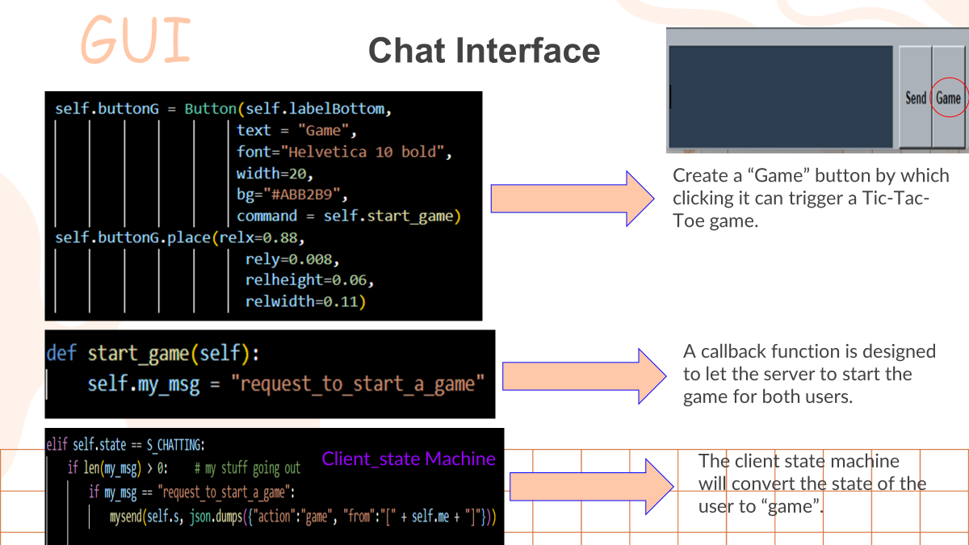
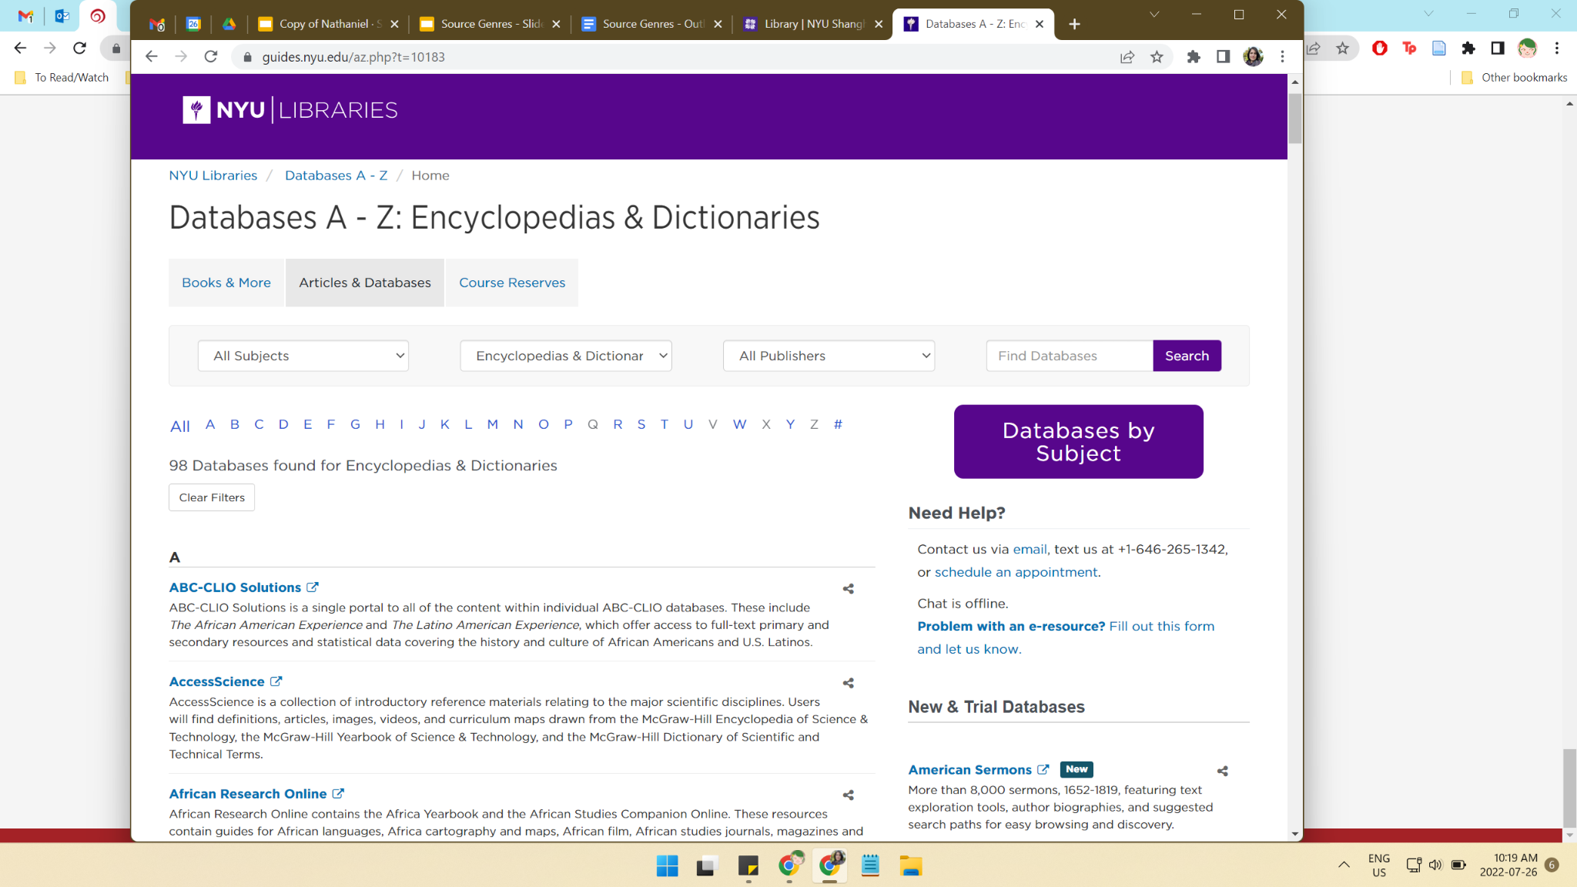
Encyclopedias and Dictionaries
Topic overviews
Learn what’s known and accepted
Find key citations and references
Learn new vocabulary in a discipline
Notes:
Encyclopedias can be useful for getting an overview of an unfamiliar topic, understanding what researchers in the area generally know and accept about an idea, and finding citations and references to key research on a topic. Academic dictionaries are useful for learning new vocabulary and understanding how a word is used in a certain discipline.

Slide 9
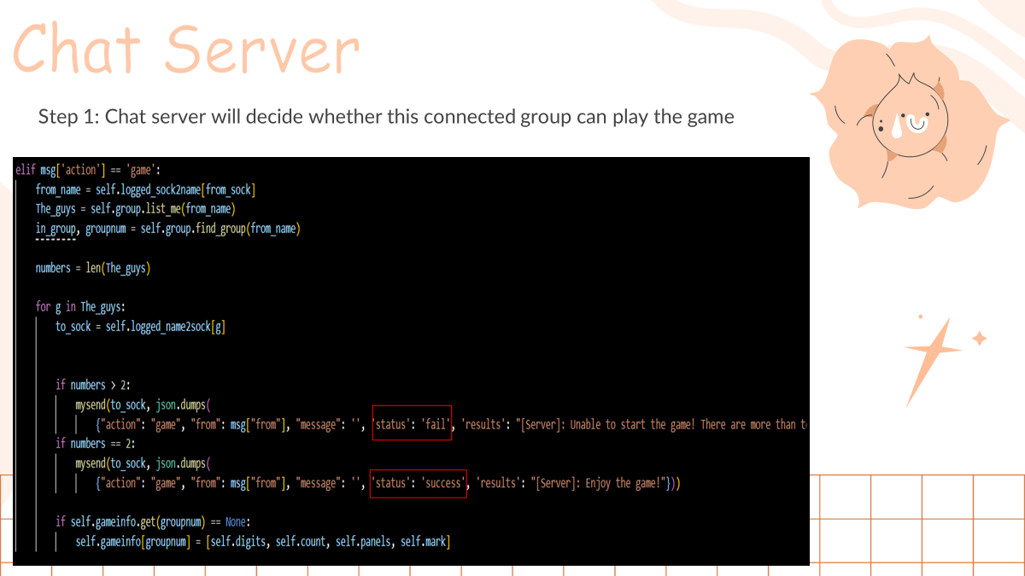

Slide 10
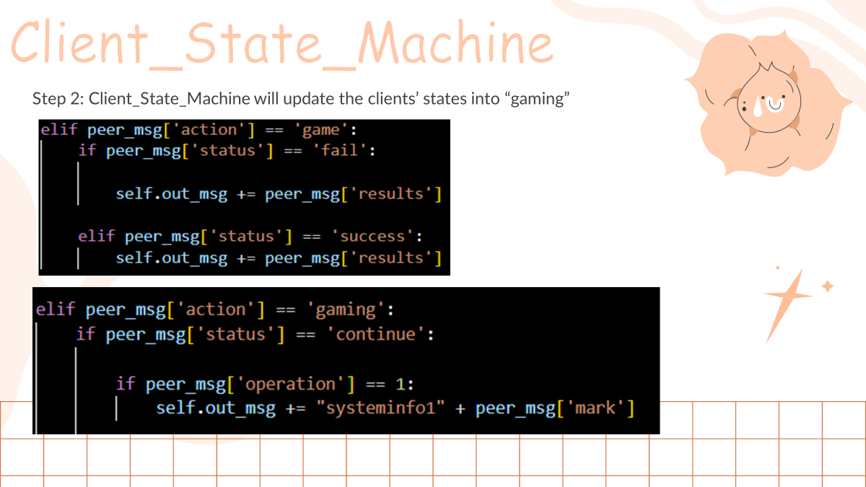

Slide 11
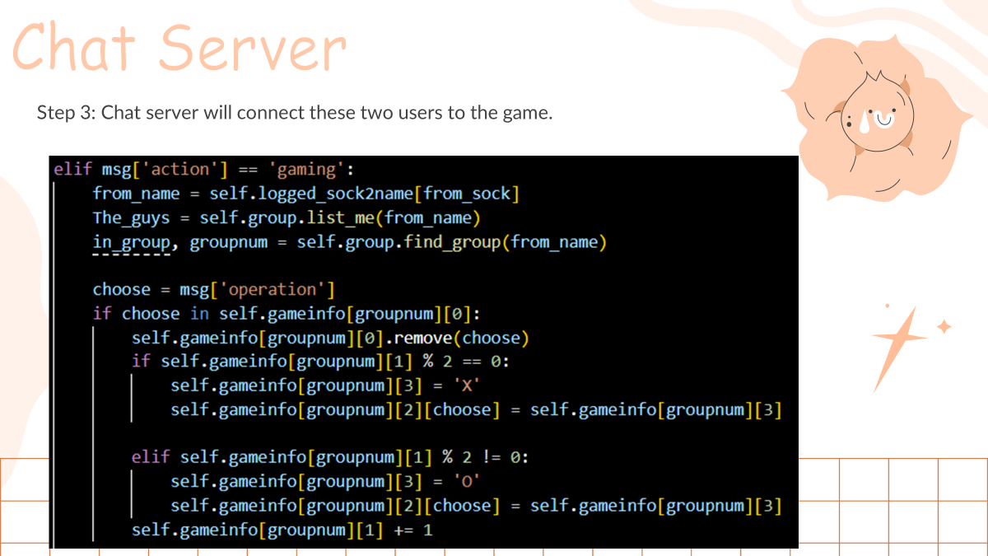

Slide 12
Secure Messaging
Notes:
Books

Slide 13
RSA
Widely Used
High security
RSA (Rivest–Shamir–Adleman)
is a public-key cryptosystem
that is widely used for secure
data transmission.
The security of RSA relies on
the practical difficulty of
factoring the product of two
large prime numbers, the
"factoring problem".

Slide 14
How does it work
The algorithm will generate 2 keys using 2 large prime number.
(one public that use to encrypt and one private used to decrypt)
Messages can be encrypted by anyone, via the public key, but can
only be decrpyted by someone who knows the private key.

Slide 15
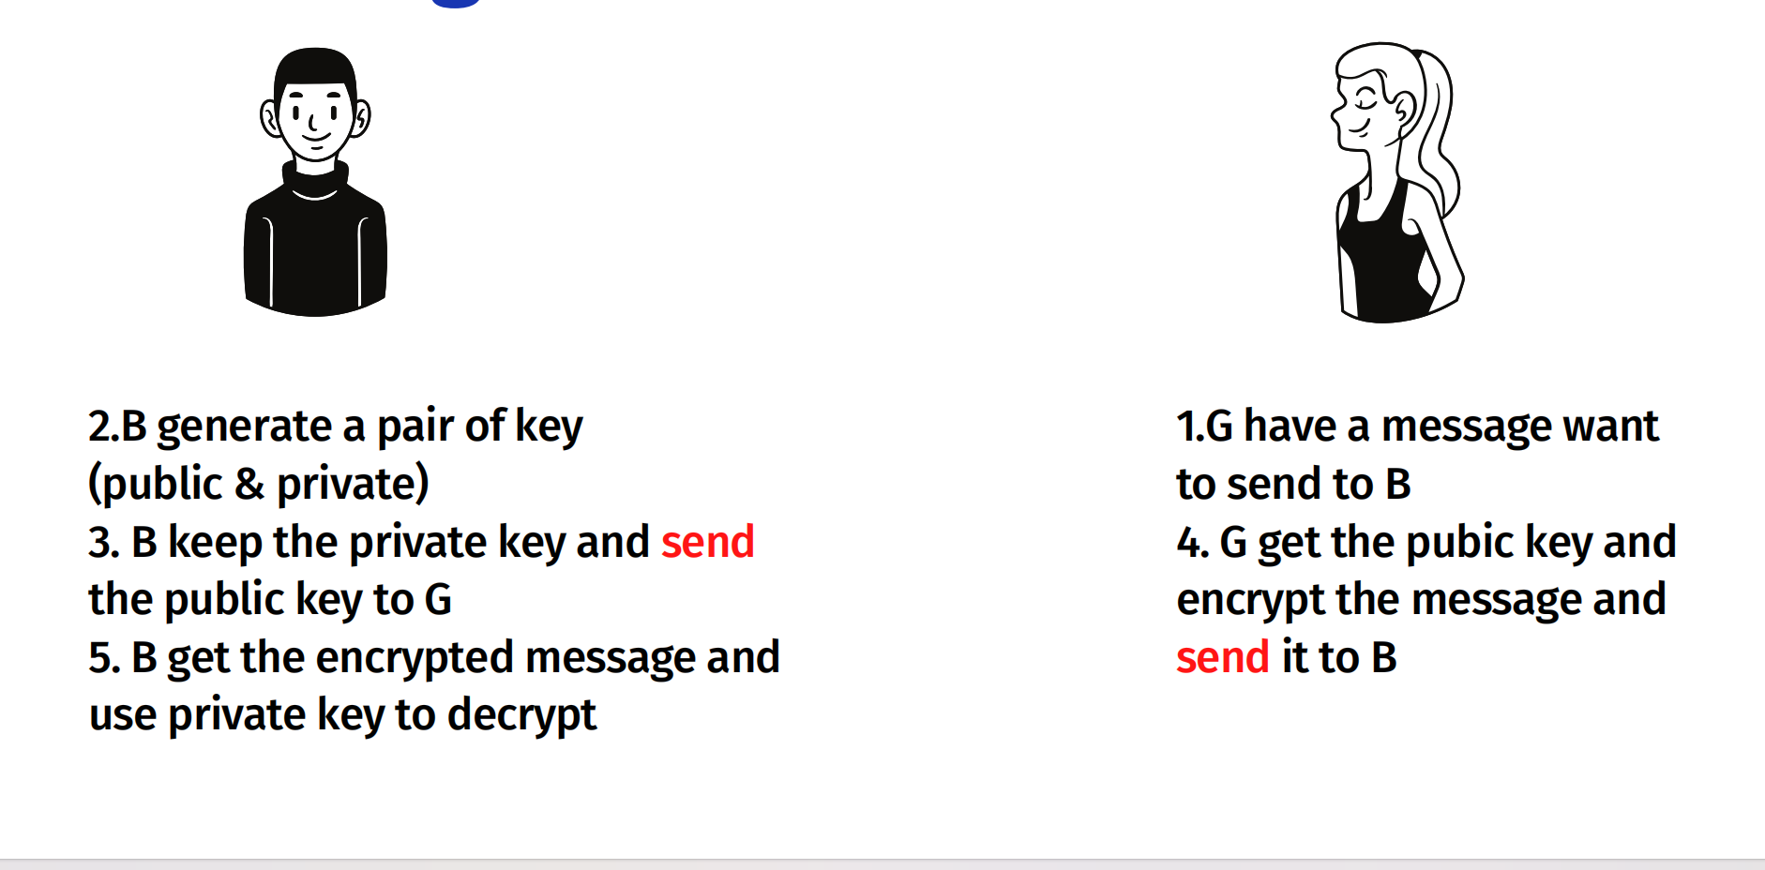
Working Flow

Slide 16

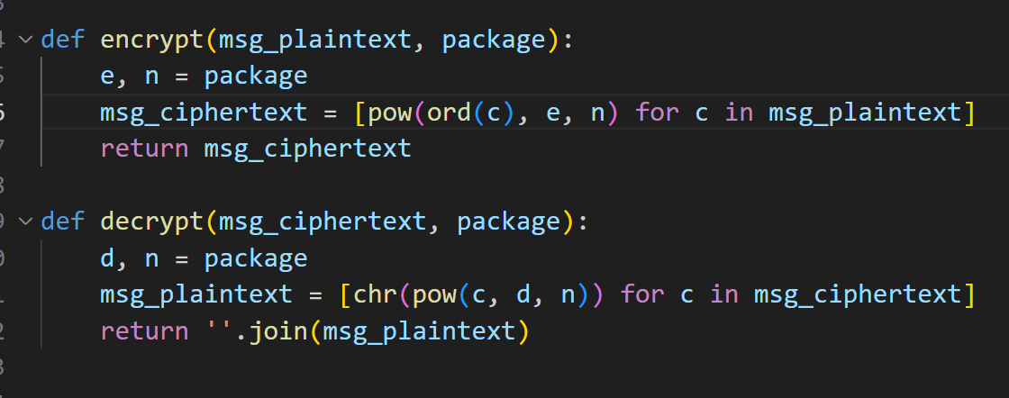
Awef
RSA Algorithm

Slide 17
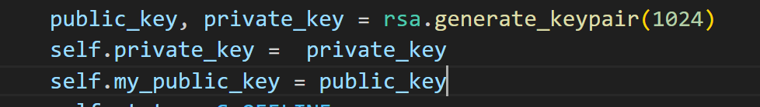
Workflow
Generate public_key and private_key using RSA package
Send my_public_key to the server when it connects to other

Slide 18
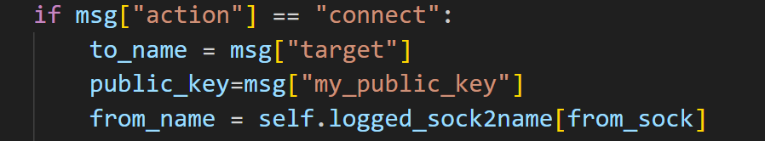
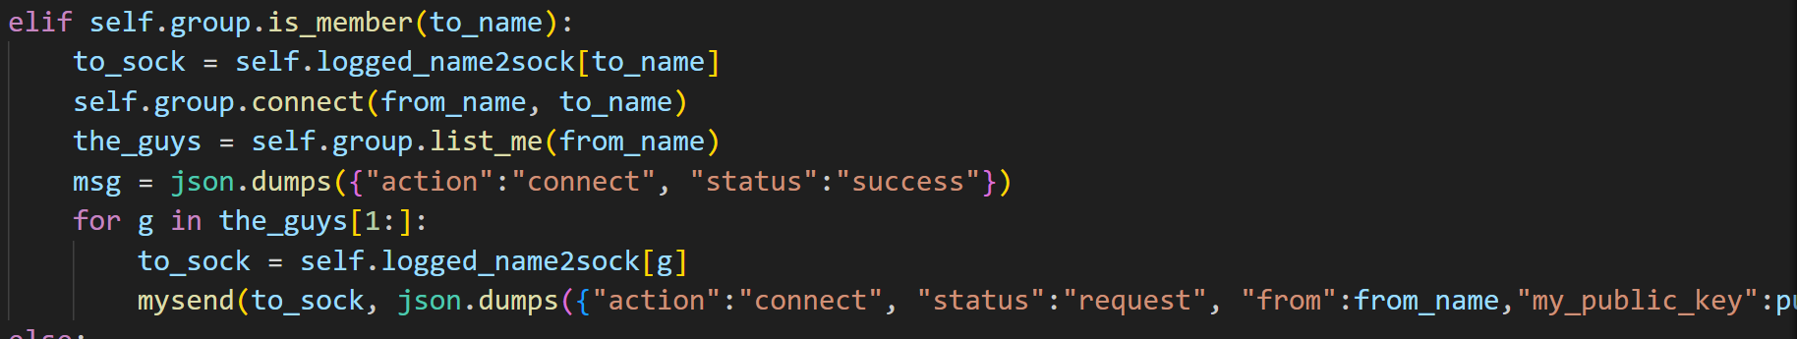
Workflow
The server receive the key and send it to the members in groups

Slide 19
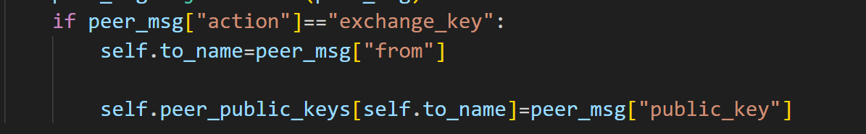
Workflow
For the receiver, he need to save the public_key into a dictionary
And then he sends his public_key back to the sender and the sender saves it into a dictionary

Slide 20

Workflow
Now everyone has members’ public_key
When they want to chat they can use the public_key to encrypt the message

Slide 21
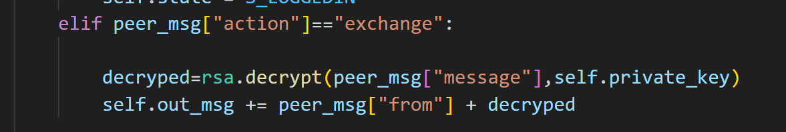
Workflow
Now everyone has members’ public_key
The receiver will decrypt the message using the private key

Slide 22
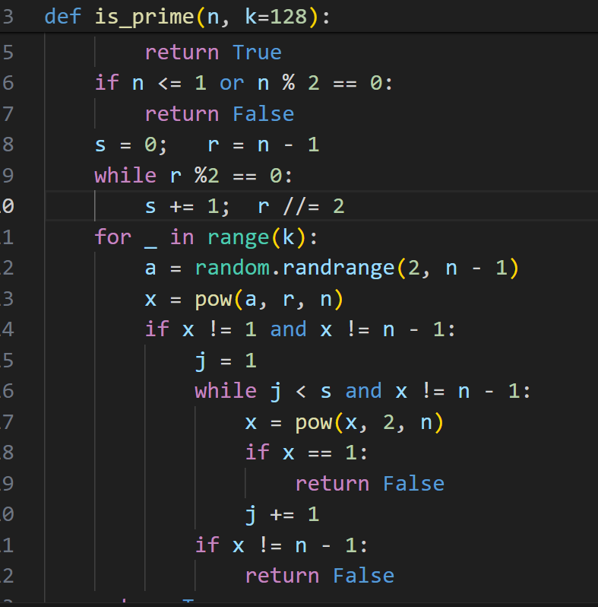
Advantage and future improvement
Miller-Rabin prime number test
Traditional RSA uses two large prime numbers, but the algorithm can be improved by using more primes. Multi-prime RSA can increase the efficiency of encryption and decryption while maintaining a similar level of security.
For enhanced security, RSA can be combined with other cryptographic techniques, such as Elliptic Curve Cryptography (ECC) or post-quantum cryptographic algorithms. This hybrid encryption approach can provide additional security under current technological conditions.

Slide 23
Online Gaming
Notes:
Journal Articles

Slide 24
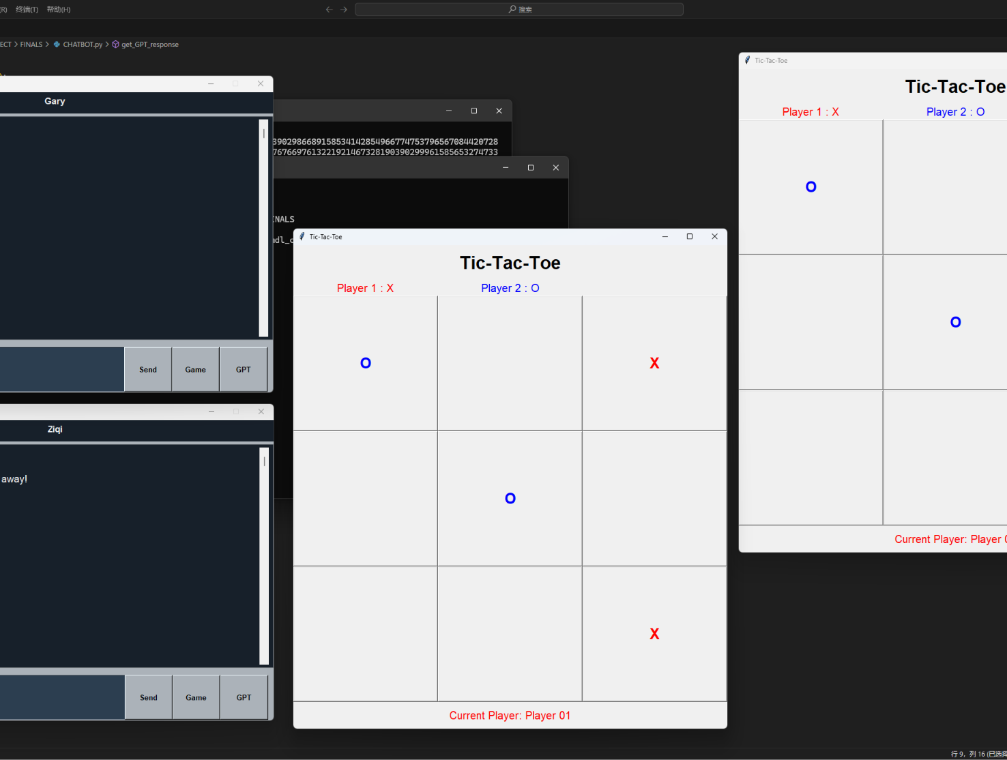
Tic-Tac-Toe
Game of 2 Players
Enhanced Gaming Experience
Easy and Fun
Notes:
Encyclopedias can be useful for getting an overview of an unfamiliar topic, understanding what researchers in the area generally know and accept about an idea, and finding citations and references to key research on a topic. Academic dictionaries are useful for learning new vocabulary and understanding how a word is used in a certain discipline.

Slide 25
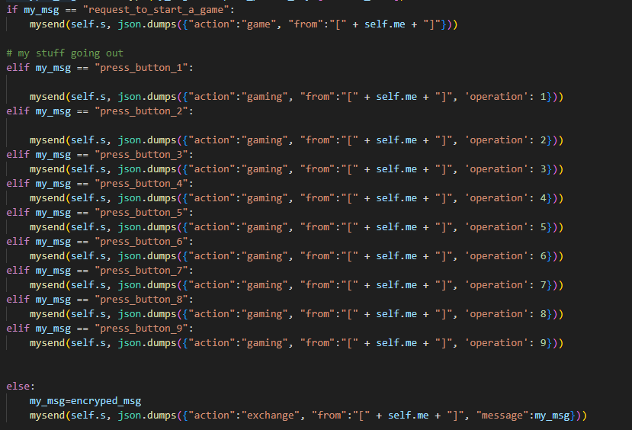
Codes
chat_state_machine.py
When chatting:
Request to start the game
Press different buttons
Give out message in json
Notes:
Encyclopedias can be useful for getting an overview of an unfamiliar topic, understanding what researchers in the area generally know and accept about an idea, and finding citations and references to key research on a topic. Academic dictionaries are useful for learning new vocabulary and understanding how a word is used in a certain discipline.

Slide 26
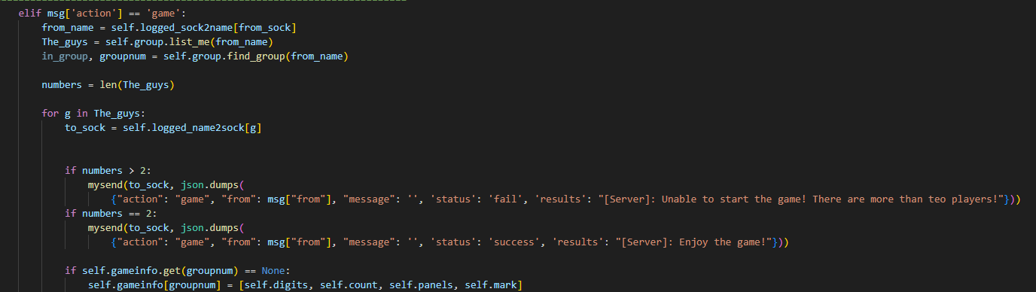
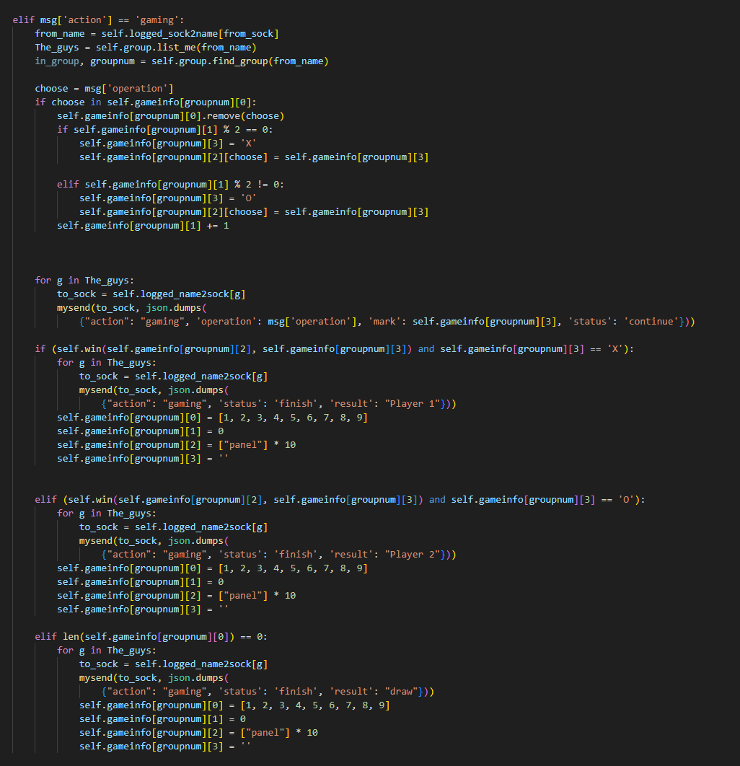

Codes
chat_server.py
In server:
Receiving requests
Checking player number
Sending results
Checking winer
Notes:
Encyclopedias can be useful for getting an overview of an unfamiliar topic, understanding what researchers in the area generally know and accept about an idea, and finding citations and references to key research on a topic. Academic dictionaries are useful for learning new vocabulary and understanding how a word is used in a certain discipline.

Slide 27
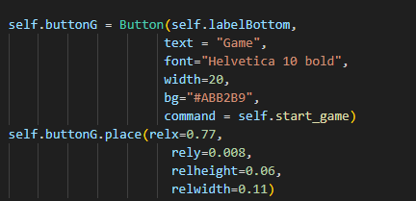
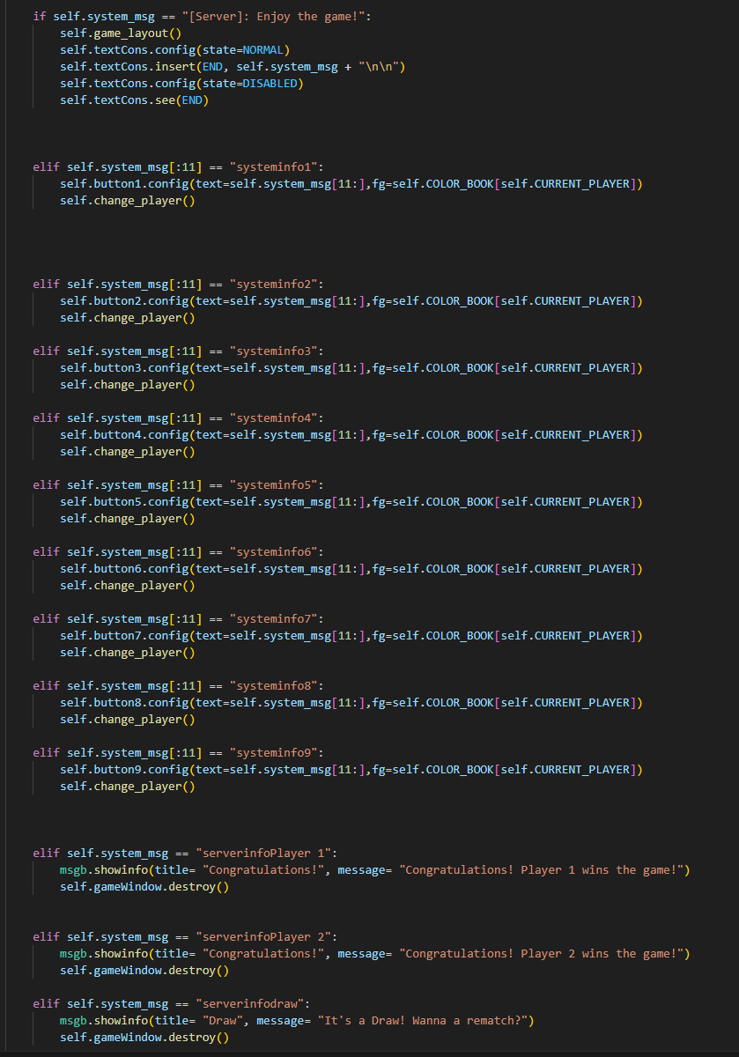
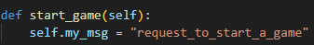
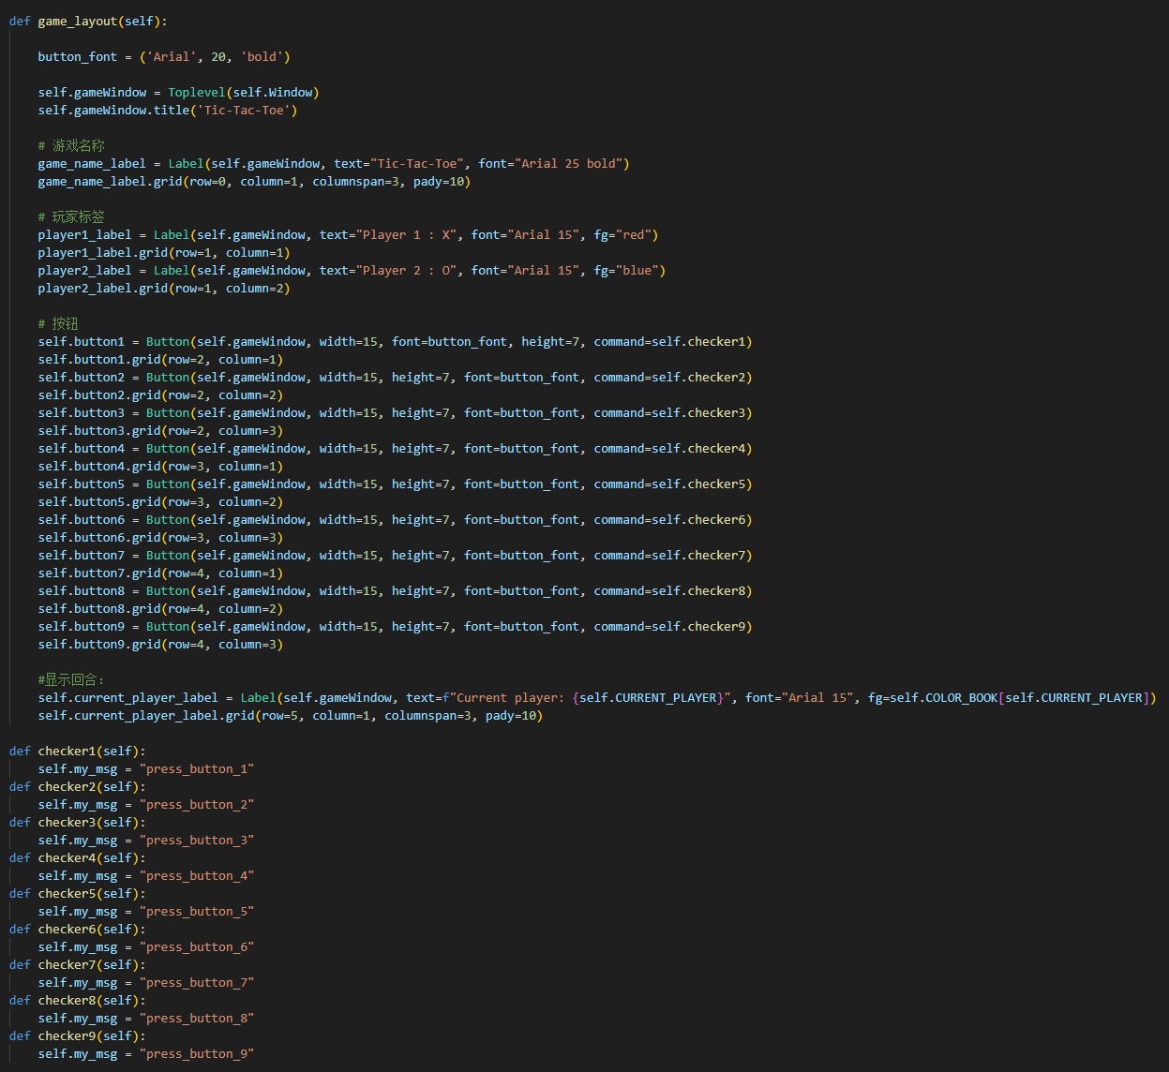
Codes
GUI.py
In GUI (client side):
Sending requests
Monitoring instructions
Displaying results
Notes:
Encyclopedias can be useful for getting an overview of an unfamiliar topic, understanding what researchers in the area generally know and accept about an idea, and finding citations and references to key research on a topic. Academic dictionaries are useful for learning new vocabulary and understanding how a word is used in a certain discipline.

Slide 28
GPT Integration
Notes:
Newspaper and Magazine Articles

Slide 29
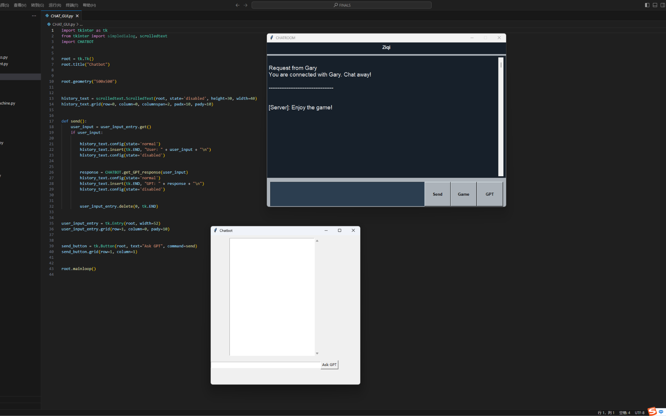
GPT Integration
Access ChatGPT
gpt-3.5-turbo
Notes:
Articles published in newspapers and magazines are usually “popular” sources aimed at the public. That means they usually have less jargon or technical terms than academic sources, but they also often have less detail and aren’t written by expert researchers. Different newspapers and magazines vary a lot in reliability, and these sources should be evaluated carefully. Still, these popular articles can be useful for finding information that isn’t available in academic sources.

Slide 30
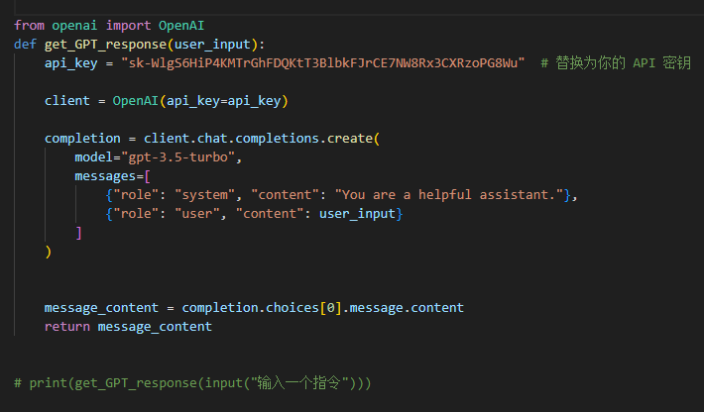
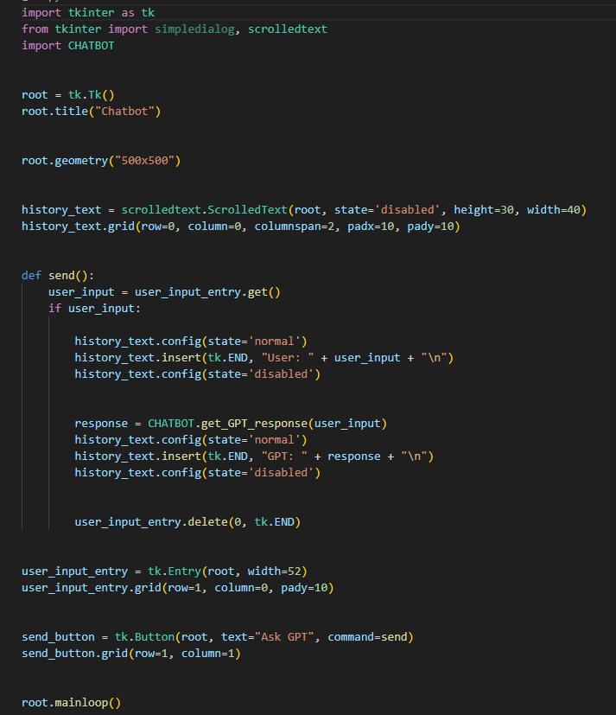
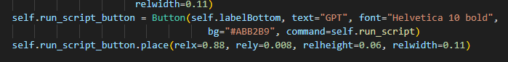
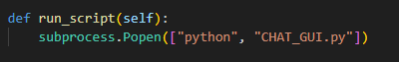
codes
CHATBOT.py
Get GPT response
CHAT_GUI.py
GPT_GUI
GUI.py
A button to access the GPT_GUI
Notes:
Encyclopedias can be useful for getting an overview of an unfamiliar topic, understanding what researchers in the area generally know and accept about an idea, and finding citations and references to key research on a topic. Academic dictionaries are useful for learning new vocabulary and understanding how a word is used in a certain discipline.

Slide 31
Analysis
Notes:
Websites

Slide 32

Packages used
tkinter
Openai
RSA(written by ourselves)
Json
Socket
Notes:
Many of the sources we’ve already talked about can be found online, which means that both academic and non-academic information can be on websites. But, most sources that are only websites, and not an online version of another source type, are “popular” sources aimed at the public.You’ll usually find these popular sites through a search engine, while academic sources are easiest to find through NYU Shanghai library.
Websites are usually not considered as reliable or authoritative as other traditionally published sources, because they can be created and published without any oversight or editing. They can change at any time, and some websites make it difficult to link directly to a specific page or bit of information. In addition to evaluating information on websites carefully, it’s important to click around and look for a web page title, author, and stable link. Make sure you understand where the information is coming from.

Slide 33
Future Prospects
Changing the password as users wish?
Games that can include more people?
Integrating more AI models?
Using multi-prime numbers in the rsa
And more…
Notes:
Many of the sources we’ve already talked about can be found online, which means that both academic and non-academic information can be on websites. But, most sources that are only websites, and not an online version of another source type, are “popular” sources aimed at the public.You’ll usually find these popular sites through a search engine, while academic sources are easiest to find through NYU Shanghai library.
Websites are usually not considered as reliable or authoritative as other traditionally published sources, because they can be created and published without any oversight or editing. They can change at any time, and some websites make it difficult to link directly to a specific page or bit of information. In addition to evaluating information on websites carefully, it’s important to click around and look for a web page title, author, and stable link. Make sure you understand where the information is coming from.

Slide 34
Thank you!
Notes:
Remember that different types of sources cover different content, and can be useful for different purposes in your research.
Academic sources are useful for learning more about a topic from experts. Encyclopedias and dictionaries give an overview of a topic, and work well as an introduction when you’re new to a subject. Books can give in-depth information about a topic, while chapters in edited volumes can give in-depth information about a subtopic. Journal articles share research about a very specific idea or question.
Non-academic or “popular” sources are not considered as reliable as academic sources, but they can be useful for learning about events, organizations, and public opinion.

